Slide 1
African
Cultures
Arab, Ashanti, Bantu, & Swahili

Slide 2
Standards
SS7G4 The student will describe the diverse cultures of the people who live in Africa.
a. Explain the differences between an ethnic group and a religious group.
b. Explain the diversity of religions within the Arab, Ashanti, Bantu, and Swahili ethnic groups.

Slide 3
African
Cultures
Arab, Ashanti, Bantu, & Swahili

Slide 4
Ethnic Group
This is a group of people who share a common culture.
These characteristics have been part of their community for generations.
Ethnic groups can have many things in common:
Shared history, common ancestry, language, religion, traditions, beliefs, holidays, food, etc.
All of these things make up a common culture that is shared by the members of the ethnic group.

Slide 5
Religious Group
This is a group of people who share a belief system. They believe in the same god (or gods) and have common sacred text with a specific set of rules about how to live.
Religious groups have many things in common:
God(s), prophets, prayers, history, sacred text, religious laws, holy days, etc.
People from different ethnic groups may share the same religion; however, they may be from different cultures.

Slide 6
Traditional African Religions
Most Africans today are either Muslim or Christian, but traditional religions and customs still play a role in African culture.
Characteristics of traditional African religions include:
Storytelling:
Creation stories
Kings are seen as gods
Ancestor worship
Rituals including art, music, fire, dance, food, drink
Charms and amulets
Animism:
Belief in spirits in nature
Prayers and offerings to spirits

Slide 7
Arabs

Slide 8
Location
Most of Africa’s Arab population is found in the countries of Northern Africa.
While the majority of Arabs are in North Africa, the gold and salt trade spread the Arab culture beyond the Sahara into the Sahel region and beyond.

Slide 9
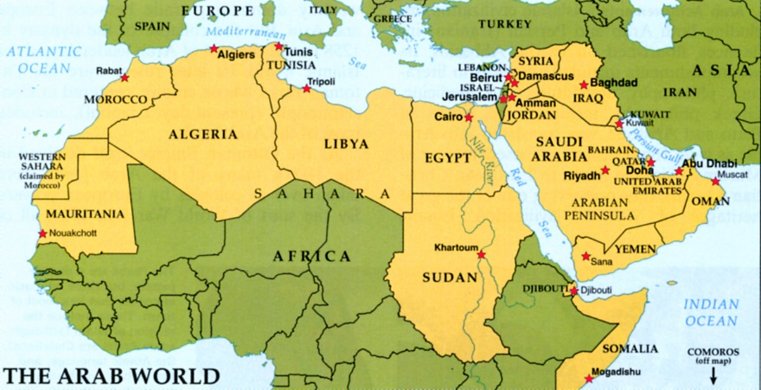

Slide 10
Ancestry
Arab people began to spread into North Africa in the late 600s, when the first Muslim armies arrived in Egypt.
Arab armies, traders, and scholars soon spread across northern Africa all the way to Morocco.
Wherever the Arabs went, they took Islam and the Arabic language with them.
Arabic was necessary to be able to read the Quran, Islam’s holy book.
The Arabic language, the religion of Islam, and many other aspects of Muslim culture became part of Africa.

Slide 11
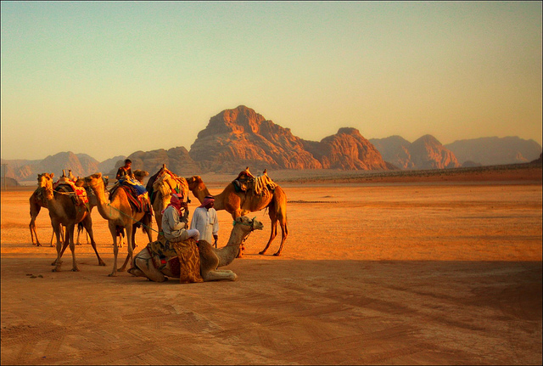
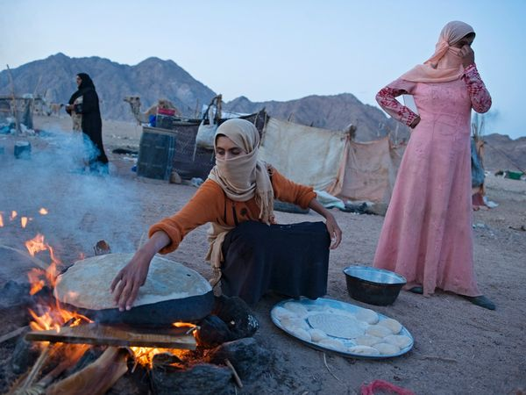

Slide 12
Religion
Most Arabs, but not all, practice Islam.
The term “Arab” also includes Arabic-speaking Christians in Syria, Lebanon, Israel, and Jordan.

Slide 13
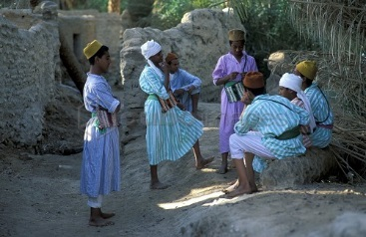
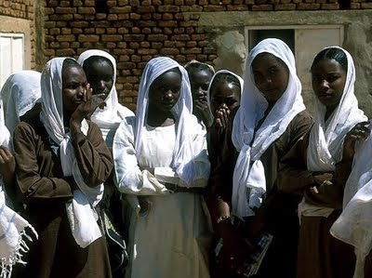

Slide 14
Language
The term “Arab” refers to an ethnic group made up of people who speak the Arabic language.
Some Jews, Kurds, Berbers, Copts, and Druze speak Arabic, but are not usually considered Arab.

Slide 15
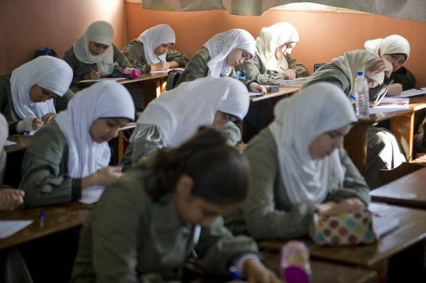
Arab Girls’ School in Egypt

Slide 16
Let’s Review
The majority of Arab people are found in Southwest Asia and northern Africa.
The language of the Arab people is Arabic.
Most Arabs, but not all, practice Islam.

Slide 17
Ashanti

Slide 18
Location
Prior to European colonization, the Ashanti people developed a large and influential empire in West Africa.
Today, they live predominately in Ghana and Ivory Coast.
The majority of Ashantis reside in Ashanti, Asanteman (currently a sub-nation within Ghana).
Asanteman has a population of 3,812,950.
The total Ashanti population is over 7 million.

Slide 19
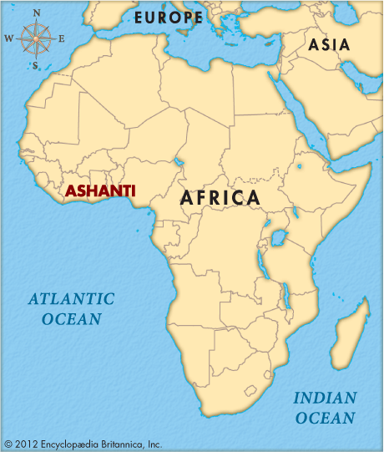
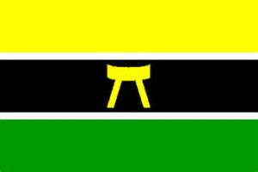

Slide 20
Ancestry
In 1701, a meeting of all the clan chiefs in the region was held.
In this meeting, a Golden Stool was produced from the heavens by a priest and landed on the lap of Osei Tutu, the first king.
The Golden Stool was declared to be the symbol of the new Ashanti kingdom.
The Golden Stool is sacred to the Ashanti, as it is believed that the kingdom will last as long as it remains in the hands of the Ashanti king.
The Golden Stool is an Ashanti legend and has only been seen by the tribe's royalty -- only the king and trusted advisers know the hiding place of the stool.

Slide 21
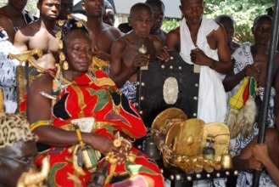
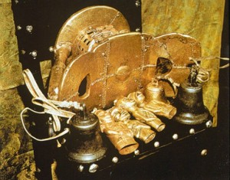
Bells are attached to the side to warn the king of impending danger.
Golden Stool of the Ashanti (Replica)

Slide 22
Religion
Ashanti believe in a supreme god who takes on various names depending upon the region of worship.
The Ashanti believe lower gods, like spirits, are on earth to assist humans.
Spirits receive their power from the supreme god and are most often connected to the natural world.
Ashanti priests serve the spirits and act as mediators between the supreme god and humans.
This is called animism – the belief that natural physical entities, including animals, plants, and features of the earth, have a spiritual essence.
Other religions (Islam & Christianity) are also practiced by many Ashanti.

Slide 23
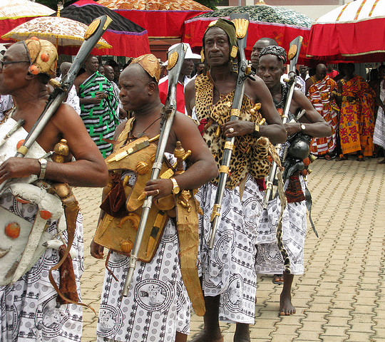

Slide 24
Language
The major dialect of the Ashanti language is called ‘Asante’, or ‘Twi’.
It is spoken in and around Kumasi, the capital of the former Ashanti empire, and within the current sub-national Asante Kingdom in Ghana.

Slide 25
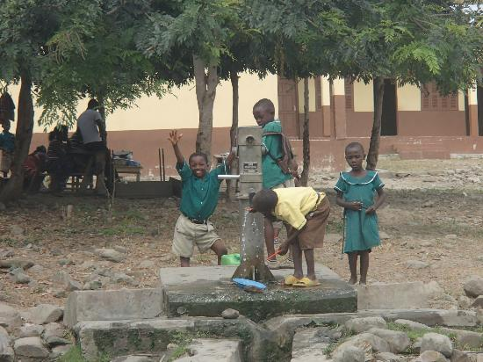

Slide 26
Let’s Review
They live predominately in Ghana and Ivory Coast.
Most speak Twi (or Asante).
The Ashanti religion is a mixture of spiritual and supernatural powers.
They believe that plants, animals, and trees have souls.
The Golden Stool legend is very important to Ashanti culture.

Slide 27
Bantu

Slide 28
Location
Bantu generally refers to nearly 600 ethnic groups in Africa who speak Bantu languages.
The Bantu people are distributed throughout central and southern parts of the continent.
Bantu make up about two-thirds of Africa’s population and cover the southern half of the continent.
The word “bantu” means “the people”.

Slide 29
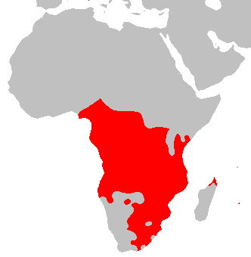

Slide 30
Ancestry
The Bantu originally came from southeastern Nigeria and Cameroon, and then spread east and south near Zambia.
Around 1000 CE, the Bantu reached present-day Zimbabwe and South Africa.
As they spread across the continent, they met many new people, learned new skills, and shared their customs and beliefs.
They intermarried with the people, accepting new traditions and blending them with Bantu culture.
Bantu-speaking people settled as far south as the southern tip of Africa.
The Bantu migration was one of the largest movements of people in Africa’s history.

Slide 31
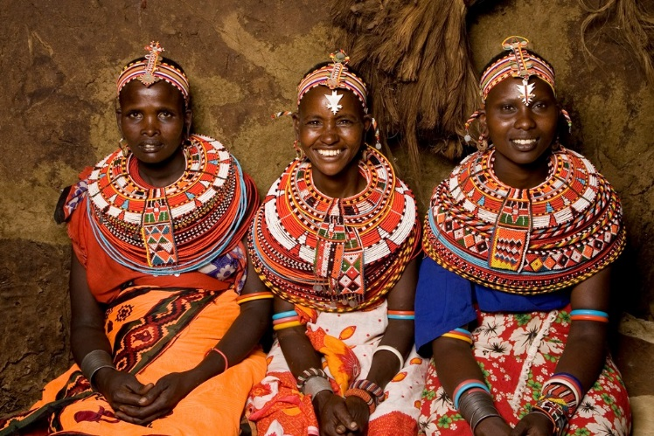
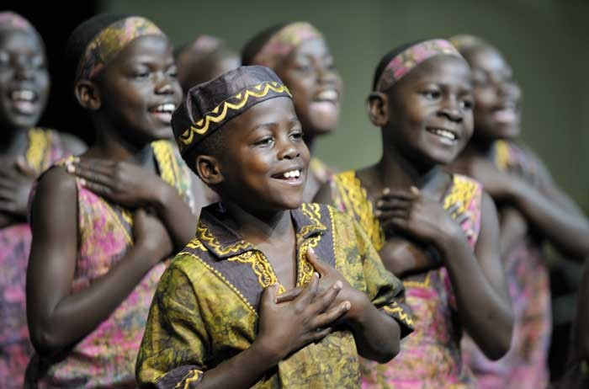

Slide 32
Religion
Many Bantu people settled in areas where there was a strong Arab presence and are now Muslim.
Other Bantu people were influenced by missionary efforts in Africa and are now Christian.
Still others follow traditional African religions, like animism.
Animists believe that spirits are found in natural objects and surroundings.

Slide 33
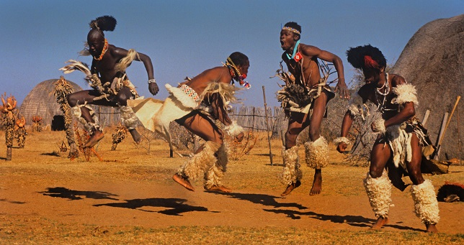
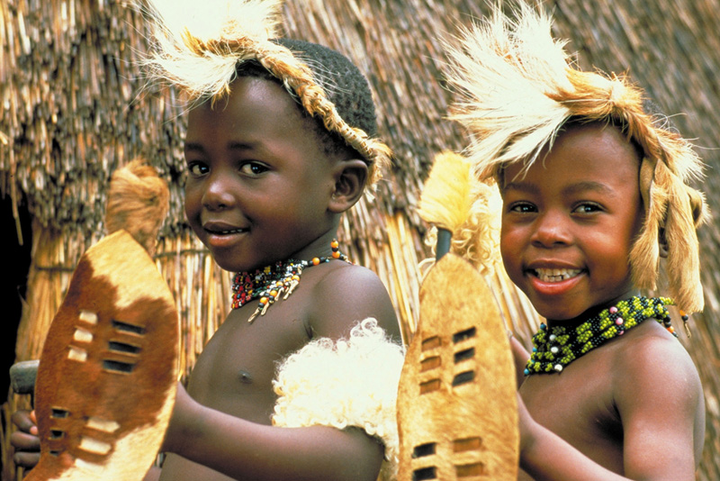

Slide 34
Language
There are over 650 different Bantu languages and dialects.
Today, close to 70 million people across the southern half of Africa speak Bantu-based languages and share some part of Bantu culture.

Slide 35
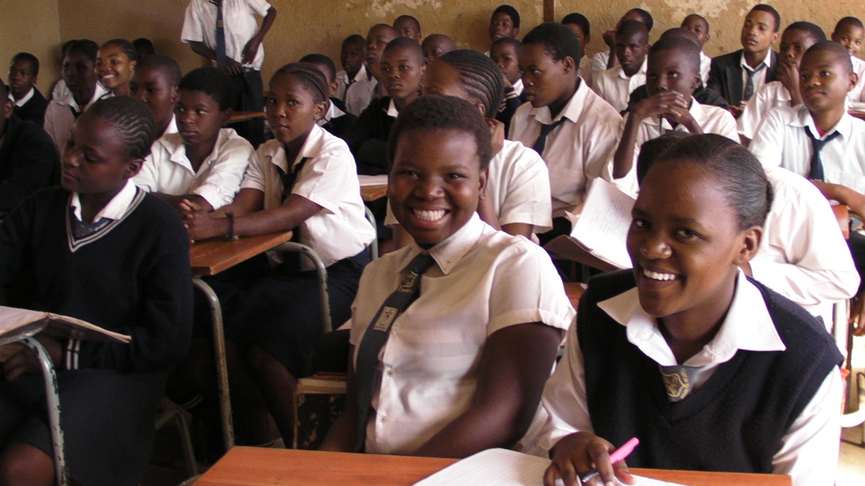
High School Classroom

Slide 36
Let’s Review
The Bantu people are found throughout Sub-Saharan Africa.
Bantu is usually known more as a language than an ethnic group.
Bantu is a mixture of nearly 600 different ethnic groups combined.
There are over 650 different Bantu languages and dialects.
Bantu practice Islam, Christianity, & traditional African religions (animism).

Slide 37
Swahili

Slide 38
Location
The Swahili people inhabit the southern coast of East Africa, in Kenya, Tanzania, & Mozambique.
Members mostly reside in the eastern African Great Lakes region, along the Swahili coast.
The total population is 1,328,000.

Slide 39
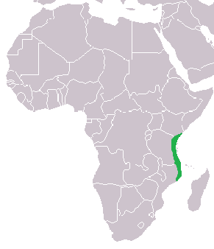

Slide 40
Ancestry
The Swahili community developed along the coast of East Africa when Arab traders began to settle there and intermarry with the local Bantu-speaking population.
The groups’ name comes from the Arabic word “Swahili,” which means “one who lives on the coast”.

Slide 41
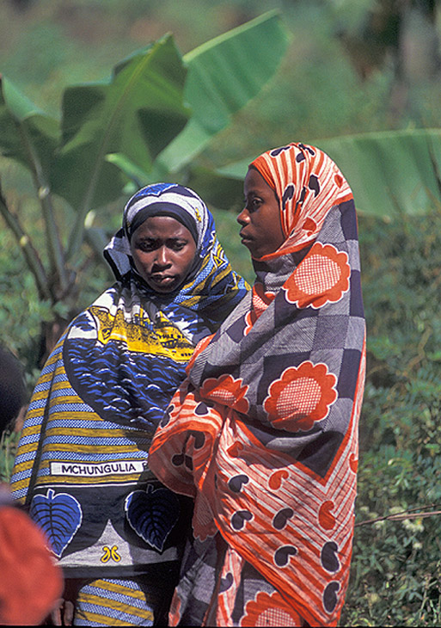
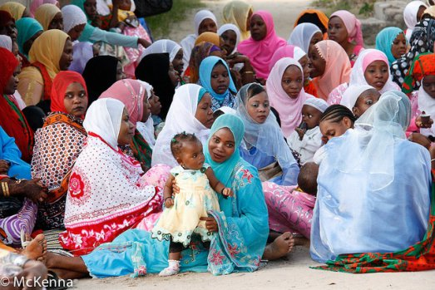
Swahili Women & Girls

Slide 42
Religion
Islam established its presence in the region during the 9th century, when Arab traders made contact with the Bantu people.
Islam has been one of the factors that helped create a common identity for such a diverse group of people.
Many among the Swahili also follow local religious beliefs that have been part of the culture of eastern Africa since before Muslim traders arrived.

Slide 43
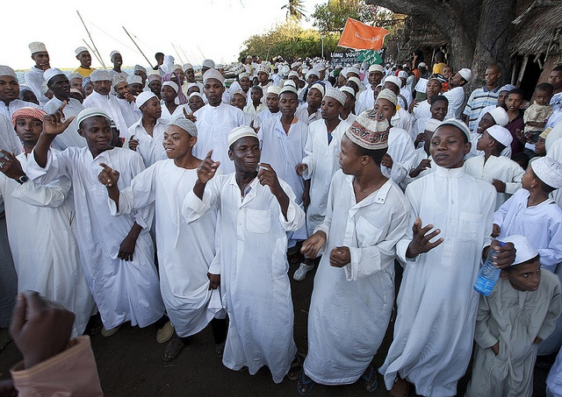
Men & Boys

Slide 44
Language
The Swahili speak the Swahili language as their native tongue.
While the Swahili language is considered a Bantu language, there are many Arabic words and phrases included as a result of interactions with early Arab traders.

Slide 45
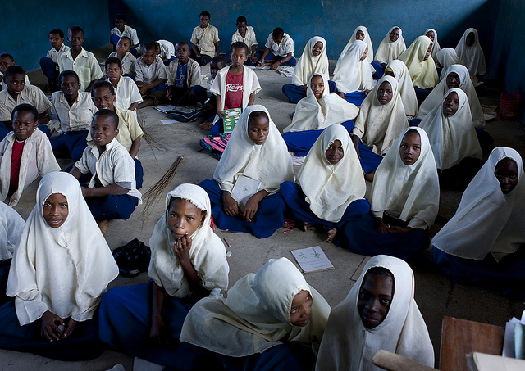
Swahili Islamic School

Slide 46
Let’s Review
The Swahili people are found in eastern Africa (Kenya, Tanzania, & Mozambique).
The language they speak is Swahili.
This is a mixture of Arabic & traditional African languages.
Most Swahili people practice Islam.

Slide 47
Credits:
All photos were found via Creative Commons and labeled for reuse.
Fonts:
Backgrounds & Graphics:

